Slide 1
ASL Character Recognition using CNNs
Atesam Abdullah, Raja Hashim Ali, Zain Ul Abideen,
Ali Zeeshan Ijaz, Nisar Ali, Abdul Bais
Sep 24th, 2023

Slide 2
Introduction
Literature Review
Gap Analysis
Methodology
Results
Conclusions
References
Outline
Notes:
I will start with the introduction of LIBS experiment and show how spectra is collected. With the collected LIBS spectra, we can conduct soil analysis. LIBS has been applied in agriculture for soil analysis, it’s also used in some other areas, such as geochemical. For example, LIBS is used to analyze the pollutants in water.
Machine learning has enhanced the development of LIBS application, but several challenges exist to its use for soil characterization. To conqueror the challenges, we propose two types of methods. One is calibration and the other one is domain adaptation.
To test the efficiency of the proposed methods, we did some experiments with an open-source dataset. We found that our methods can effectively overcome the challenges and improve the test accuracy.
However, the proposed methods are tested with only one dataset. To make the methods more reliable, we will collect more spectra data and test them with multiple datasets in the future. Then revise the methods and further improve the test accuracy.

Slide 3
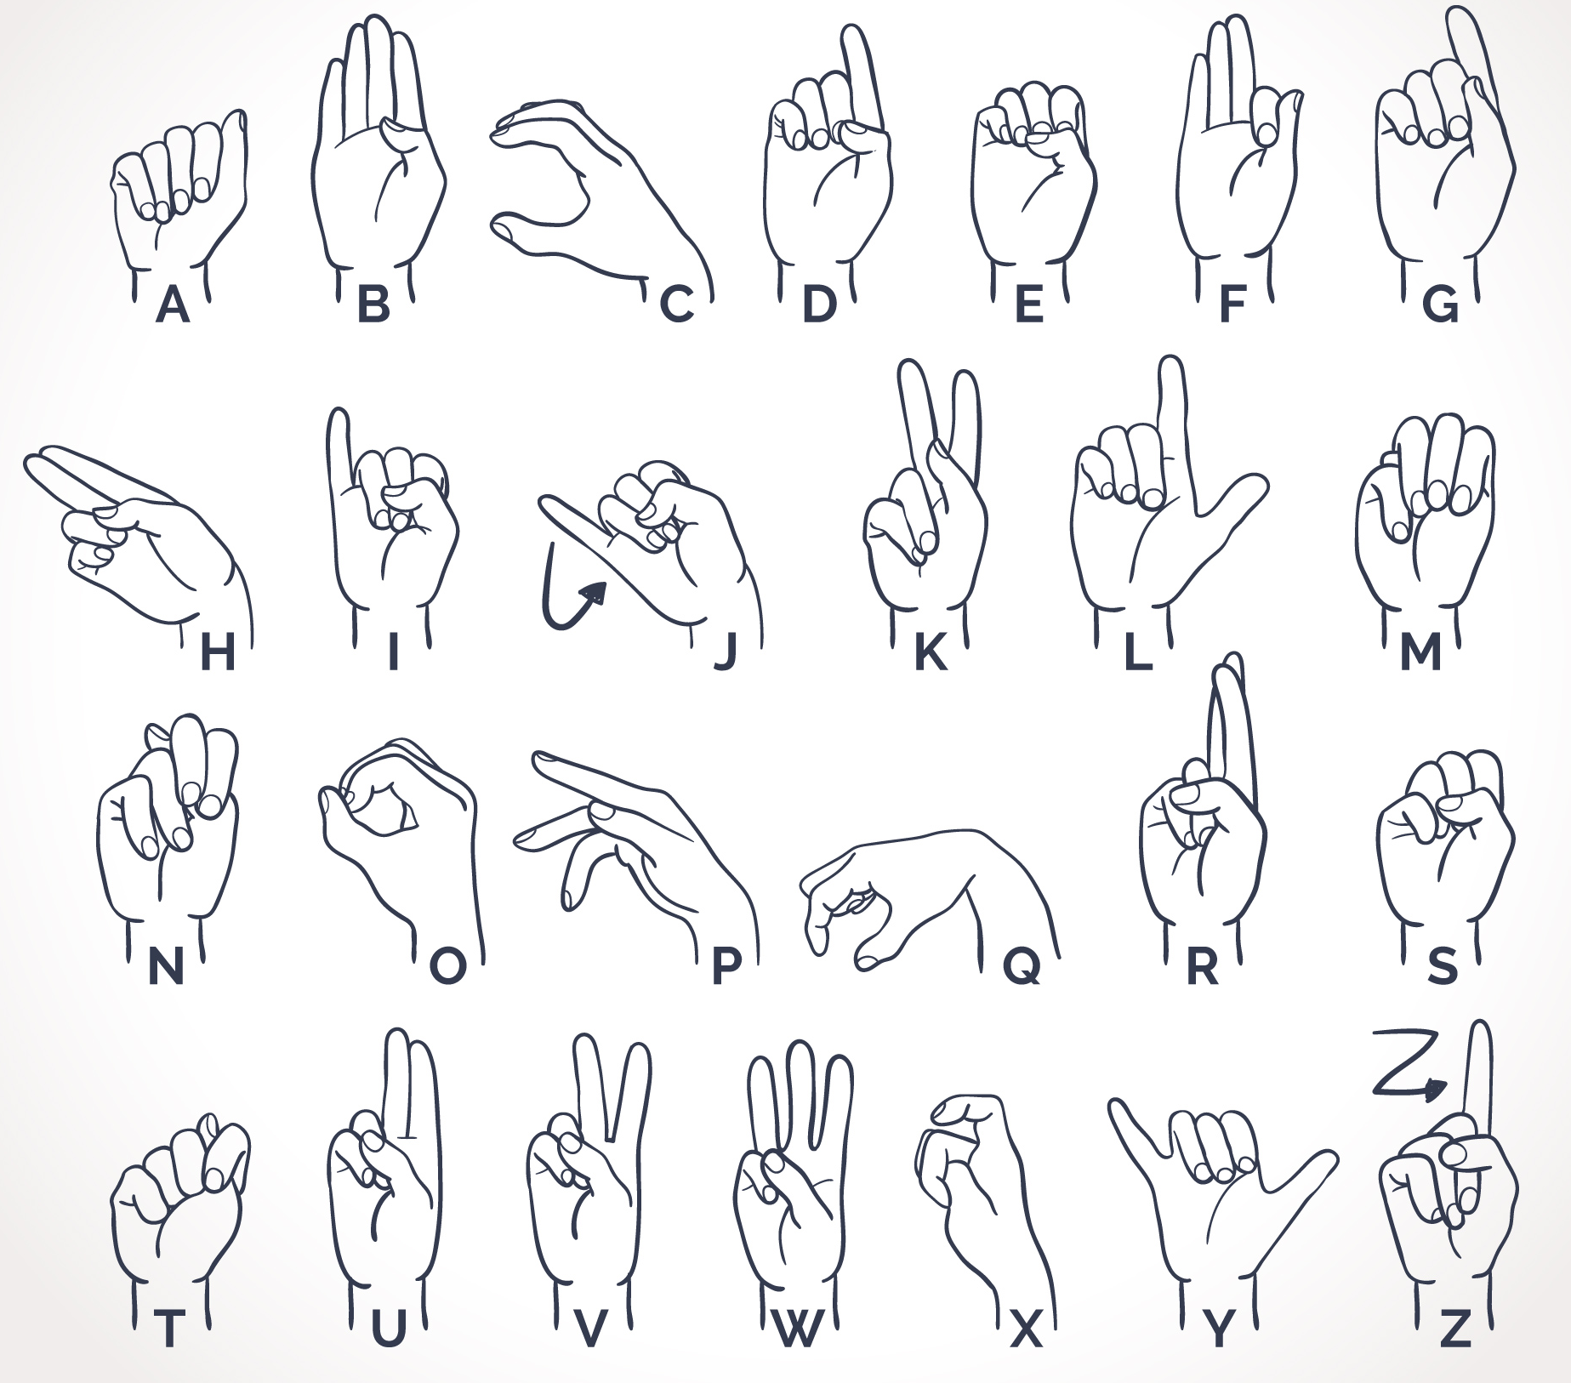
Introduction
American sign language (ASL)
A visual-gestural language for Deaf and Hard of Hearing.
Used in the U.S and Canada.
Convolutional neural network (CNN)
A deep learning algorithm for processing visual data.
Highly effective at object detection and classification.
ASL alphabets [1]

Slide 4
Literature Review
Study | Methodology | Dataset | Performance
Ahmed et al.(2022) [2] | CNN | custom | Accuracy: 99.38%
Abdul et al.(2022) [3] | DeepCNN | MNIST | Accuracy: 99.67%
Shagun et al.(2022) [4] | SVM/CNN | custom | Accuracy: 99.17%/99.14%
Sunanda et al.(2023) [5] | VGG19 | Ishara-Lipi | Accuracy: 91.11%
Yulius et al.(2023) [6] | CNN | ASL Handsign Dataset | Accuracy: 93.6%

Slide 5
Gap Analysis
Skilled ASL interpreters can be scarce in certain areas.
The cost of hiring ASL interpreters can be prohibitive.
Lack of availability in urgent or private bases.
Contribution
Explore the usage of CNNs to develop real-time ASL recognition systems, providing immediate translations without the need for human interpreters.

Slide 6
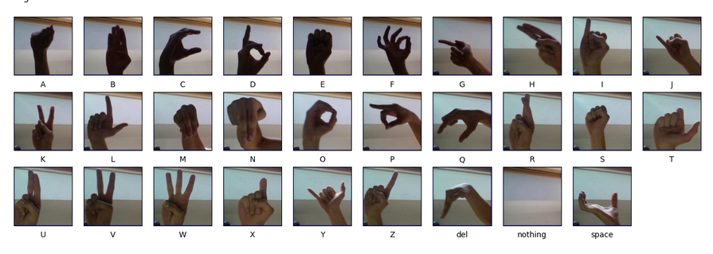
Methodology
Setup
Preprocessing
Model Configuration
Training and Optimization
Hyperparameter Tuning
Evaluation
Dataset
ASL alphabet dataset from Kaggle
87,000 images, 200x200 pixels, 29 classes (A-Z,SPACE, DELETE, NOTHING)
Dataset [7]

Slide 7
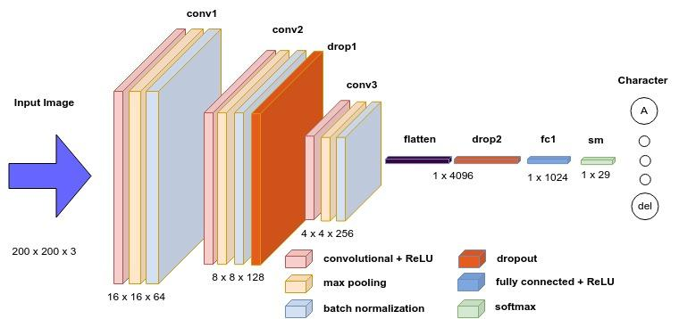
Cont…
CNN architecture and workflow [8]

Slide 8
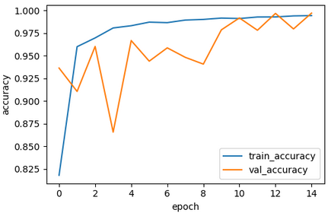
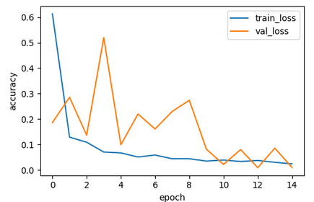
Results
Test accuracy: | 99.7%
Mean validation accuracy: | 95.48%
Plot of Accuracy/Epoch
Plot of Loss/Epoch

Slide 9
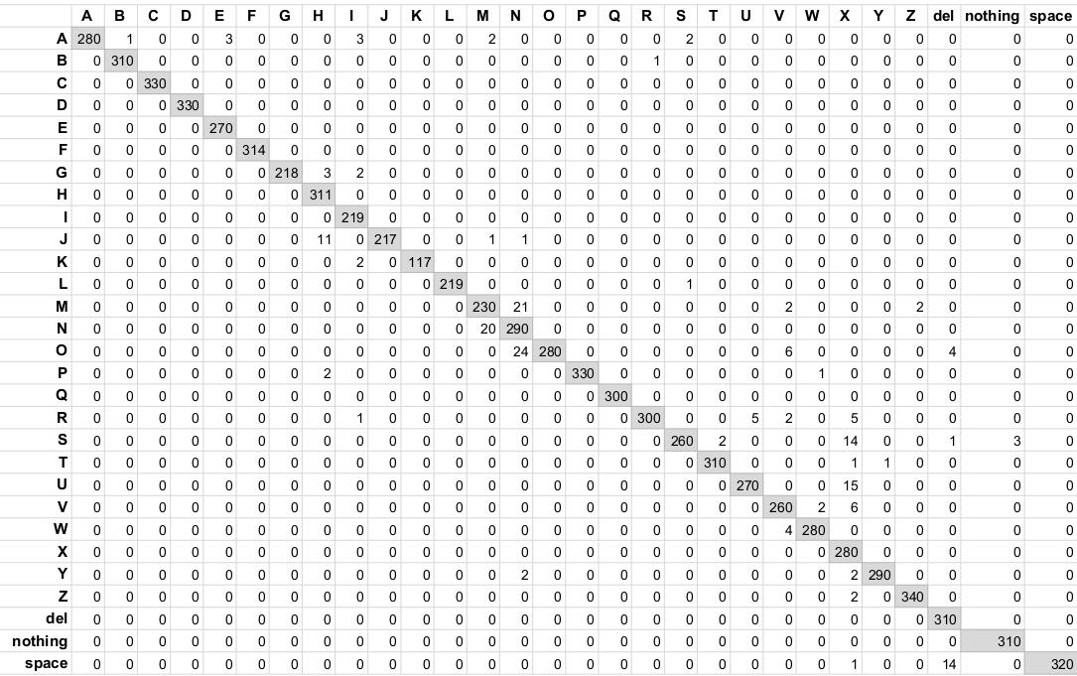
Cont…
Rows: True classes.
Columns: Predicted classes.
Cell values: Counts of instances in each class.
Diagonal elements: Correct predictions.
Off-diagonal elements: Model errors.
Confusion Matrix

Slide 10
Conclusion
Challenges persist with similar letters (e.g., A and M) in live data.
Exploring integration of landmark data to improve precision.
Continuous architecture refinement and dataset expansion are essential for future progress.
Foundational work for ASL tech advancements, benefiting education and communication for the deaf.

Slide 11
References
[1] https://www.freepik.com/free-vector/hand-gesture-language-alphabet_2776330.htm
[2] A. Kasapbaşı, A. Eltayeb Ahmed Elbushra, O. Al-Hardanee, and A. Yılmaz, "DeepASLR: A CNN based human computer interface for American Sign Language recognition for hearing-impaired individuals," Computer Methods and Programs in Biomedicine Update, vol. 2, p. 100048, 2022. DOI
[3] A. Mannan, A. Abbasi, A. R. Javed, A. Ahsan, T. R. Gadekallu, and Q. Xin, "Hypertuned Deep Convolutional Neural Network for Sign Language Recognition," Computational Intelligence and Neuroscience, vol. 2022, pp. 1–10, Apr. 2022. DOI
[4] S. Katoch, V. Singh, and U. S. Tiwary, "Indian Sign Language recognition system using SURF with SVM and CNN," Array, vol. 14, p. 100141, Jul. 2022. DOI
[5] S. Das, M. S. Imtiaz, N. H. Neom, N. Siddique, and H. Wang, "A hybrid approach for Bangla sign language recognition using deep transfer learning model with random forest classifier," Expert Systems with Applications, vol. 213, p. 118914, Mar. 2023. DOI
[6] Y. Obi, K. S. Claudio, V. M. Budiman, S. Achmad, and A. Kurniawan, "Sign language recognition system for communicating to people with disabilities," Procedia Computer Science, vol. 216, pp. 13–20, 2023. DOI
[7] https://www.kaggle.com/datasets/grassknoted/asl-alphabet?resource=download
[8] https://github.com/ATESAM-ABDULLAH/ASL-alphabet-recognition/blob/main/Paper/CNN_arch.jpg

Slide 12
Thank you!

